Slide 1


Ride Leader Training
Presented by:
Chantal Thompson
Event and Program Coordinator
Aug 6th 2020

Slide 2

Welcome!
On behalf of the Ontario Cycling Association – Thank you for coming!
Notes:
Thank you
90min in-class session
risk management
club ride guides
ride leader role description
troubleshooting situations.
On Bike Portion = basic group simulations
how to be a good ride leader
safe cycling skills
Share any of the information you find useful to others!

Slide 3
Risk Management Plan
Notes:
How many of you know and have read your club’s risk management plan?

Slide 4
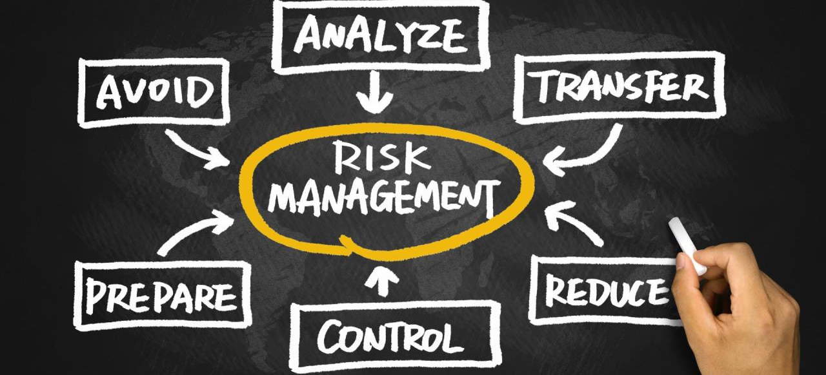
Every affiliated club needs to have one!
Notes:
*Click * Did you know that EVERY affiliated club needs to have one?

Slide 5
Why should YOU know your club’s Risk Management Plan?
Notes:
This begs a question though….
*Click *
Why should YOU know your club’s risk management plan?
Discuss….
Cycling = dangerous
Document how manage club rides by minimizing risks
Practiced by club members during every ride.
All members share responsibility for making rides as safe as possible + communicating if unsafe

Slide 6
Risk Management Plan
Anything you find interesting?
Ontario Highway Traffic Act
Proof of membership
Lightning policy
Group sizes + distance between groups
No rider left behind
Helmets mandatory
Condition of bike
Lights
Notes:
Anything notable when reading your club’s risk management plan? – Discuss
*Click* through slides
• Large number of riders: break into smaller groups (6-12)
Ride at least 100 metres apart
• Riders should not be left behind during a club ride
confirm with the ride coordinator(s) detaching from group
If you run a drop ride, you should have a separate drop ride risk management plan (need confirmation that they are disengaging from the ride, or follow up)
• Members should also be physically capable and approved medically to participate in the ride

Slide 7
Organized Activity Submission
Notes:
In order to hold regular club rides, or special events, the club has to submit a list of their activities to the OCA for approval

Slide 8
Organized Activity Submission
Completed beginning of season (with club affiliation paperwork)
Requests can be made to Membership Manager
  Up to 2 business days before activity
Notes:
Some basic information is included….
*Click*
Date, Time, Description and Location for instance
*Click*
This is typically done at the beginning of the season along with the club’s affiliation
*Click*
But updates can be submitted to the OCA membership manager (minimum 2 business days before activity)
As ride leader, do you have to do this? – NO – but good to know the process and ensure before leading an activity that the club has reported it to the OCA

Slide 9
Ride Guide
Notes:
Your club should also have a ride guide.
Submitted at the beginning of the year along with the club affiliation paperwork
Recommended to have ride guide easily accessible to all members
It prevents confusion and excessive questions from newer riders
It allows easy integration of new riders

Slide 10
Ride Guide
Notes:
Examples and potential templates provided within the club affiliation package paperwork
(Peterborough, Waterloo and Collingwood Cycling Club)
How to access:
Clubs and Teams
Forms & Literature
Club Affiliation Package

Slide 11
Safe Riding Practices
1 foot down rule
Notes:
Let’s talk about some examples of safe riding practices that could be included in your ride guide
*click*
1 foot down rule: when you arrive at a stop sign, or stop light, always put one foot down, make it habit, instill the importance to the entire group

Slide 12
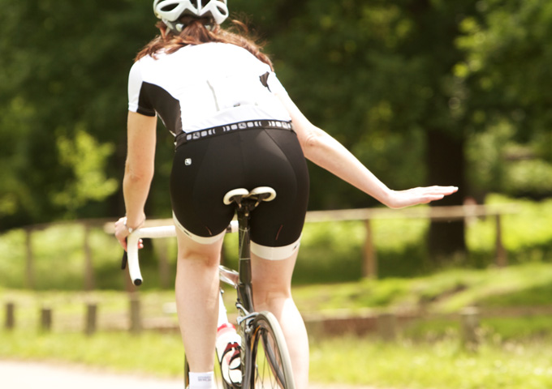
Safe Riding Practices
Hand signals and verbal commands
Notes:
Readily utilized hand signals
STOP!! *next slide*

Slide 13
Safe Riding Practices
Hand signal review!!!!
Notes:
LEFT TURN

Slide 14
Safe Riding Practices
Hand signal review!!!!
Notes:
STOPPING

Slide 15
Safe Riding Practices
Hand signal review!!!!
Notes:
SLOWING

Slide 16
Safe Riding Practices
Hand signal review!!!!
Notes:
RIGHT TURN

Slide 17
Safe Riding Practices
Hand signal review!!!!
Notes:
TRACKS

Slide 18
Safe Riding Practices
Hand signal review!!!!
Notes:
HAZARD

Slide 19
Safe Riding Practices
Hand signal review!!!!
Notes:
GRAVEL

Slide 20
Safe Riding Practices
Hand signal review!!!!
Notes:
OBSTACLE – MOVE OVER SLEIGHTLY TO AVOID

Slide 21
Safe Riding Practices
Hand signal review!!!!
Notes:
ROTATING

Slide 22
Safe Riding Practices
Hand signal review!!!!
Notes:
SINGLE OR DOUBLE FILE

Slide 23
Safe Riding Practices
“Tight to the Right”
Notes:
*click*
- ride as close to the right hand side of the road as is safe
- stay within 1m of the ridable right hand side of the road
Do not sprawl across the road making it impossible for cars to pass

Slide 24
Safe Riding Practices
Passing on the left
Notes:
Passing on the left: if you’re passing a slower moving rider, or rotating in an echelon, you want to always pass on the left

Slide 25
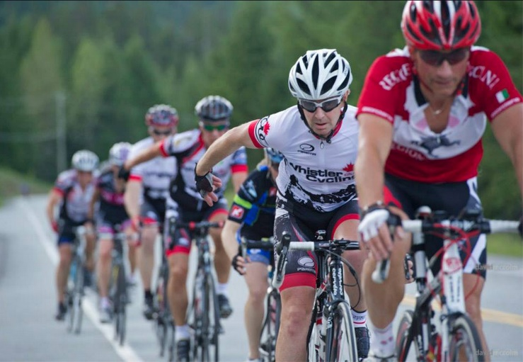
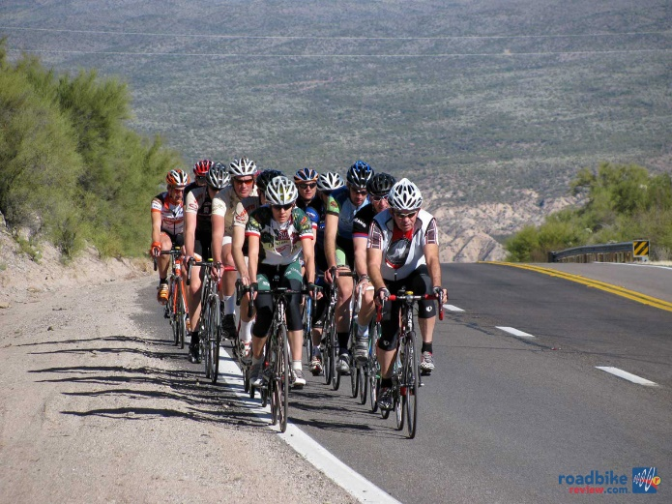
Safe Riding Practices
Types of pacelines
Notes:
Single line paceline – narrow roads, busy traffic
Double line paceline
EZ Echelon: constant rotation
avoid regional traffic laws
left lane is always passing the slower right lane of riders

Slide 26
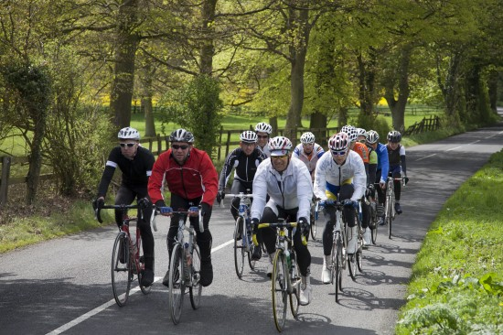
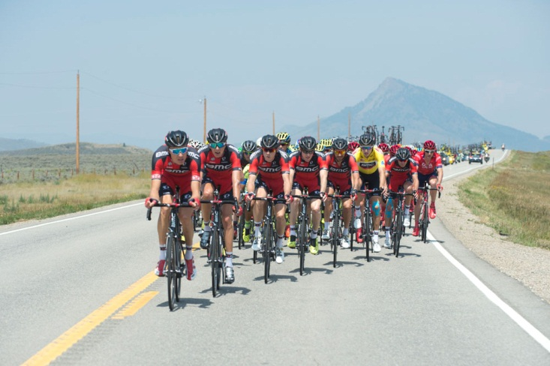
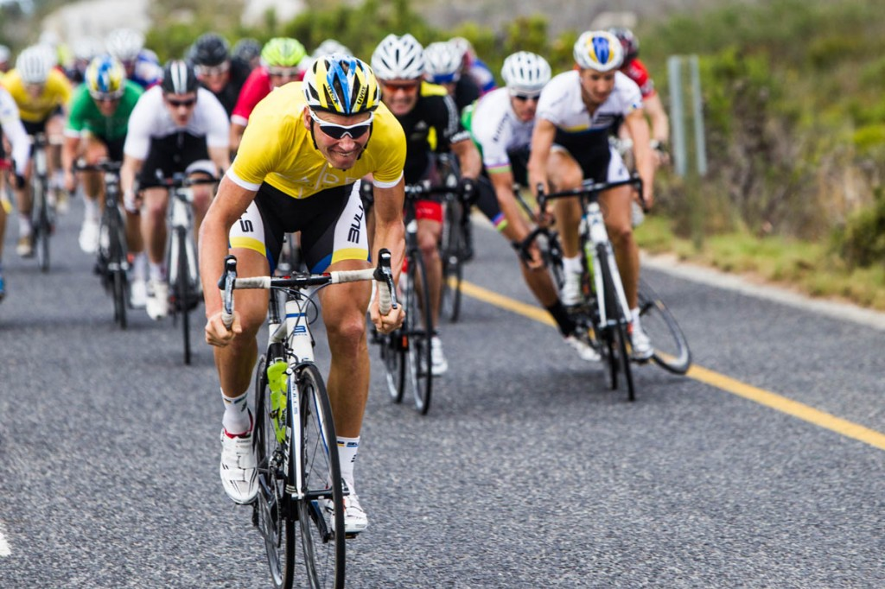
Safe Riding Practices
Unacceptable formations or behaviours
Notes:
Your club’s policies probably will mention certain behaviours that they will not tolerate such as:
*Click*
Diagonal echelon based on wind direction
*click*
Spreading across the entire lane (making it difficult to pass)
*click*
- town line sprints or KOM sprints

Slide 27
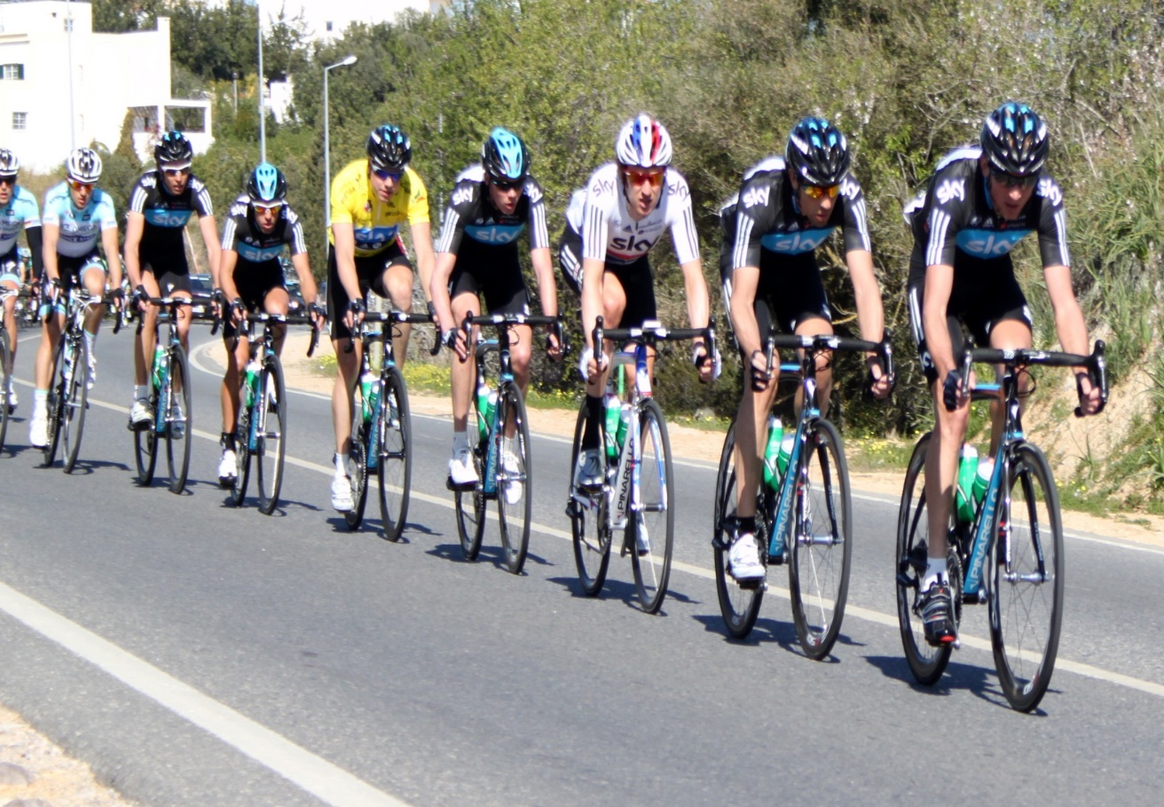
Safe Riding Practices
Group size and formations
Notes:
Recommend group sizes remain between 6-12 riders
If more than that, the group becomes unmanageable
Single line pacelines end up snaking across the road
Cars have trouble passing safely
Groups can also be made based on ability/speed levels too to ensure all riders are in a group that caters to their needs

Slide 28
Safe Riding Practices
Traffic interactions and passing
“Car Back”
Notes:
There are benefits to certain forms of paceline riding – the club’s ride guide may outline their accepted paceline formations to best allow for the safe passing of traffic
Single line pacelines keep the group closer to the right, however passing distance needed is longer than
*click*
Double line or echelon paceline passing distance
-riding two wide prevents “snaking effect” of single line and also allows for cars to complete their pass in ½ the distance

Slide 29

As ride leader, is this my job??
Notes:
This is a lot of information,
3X *click*
a lot of paperwork….
2X*click*
So, as ride leader,
*click*
is this my job??!?!

Slide 30
NO!
* BUT it’s good to make sure that your club is doing all of this
* It’s important to have these resources available – especially for new riders!!
Notes:
ABSOLUTLY NOT
Completed at the beginning of the year, during club affiliation
Most of this info transferred from year to year
HOWEVER
It’s good to make sure your club is creating and supporting their documentation
Risk management
Organized activities
Ride guide
Great resource for all members of the club to review
New riders for instance

Slide 31
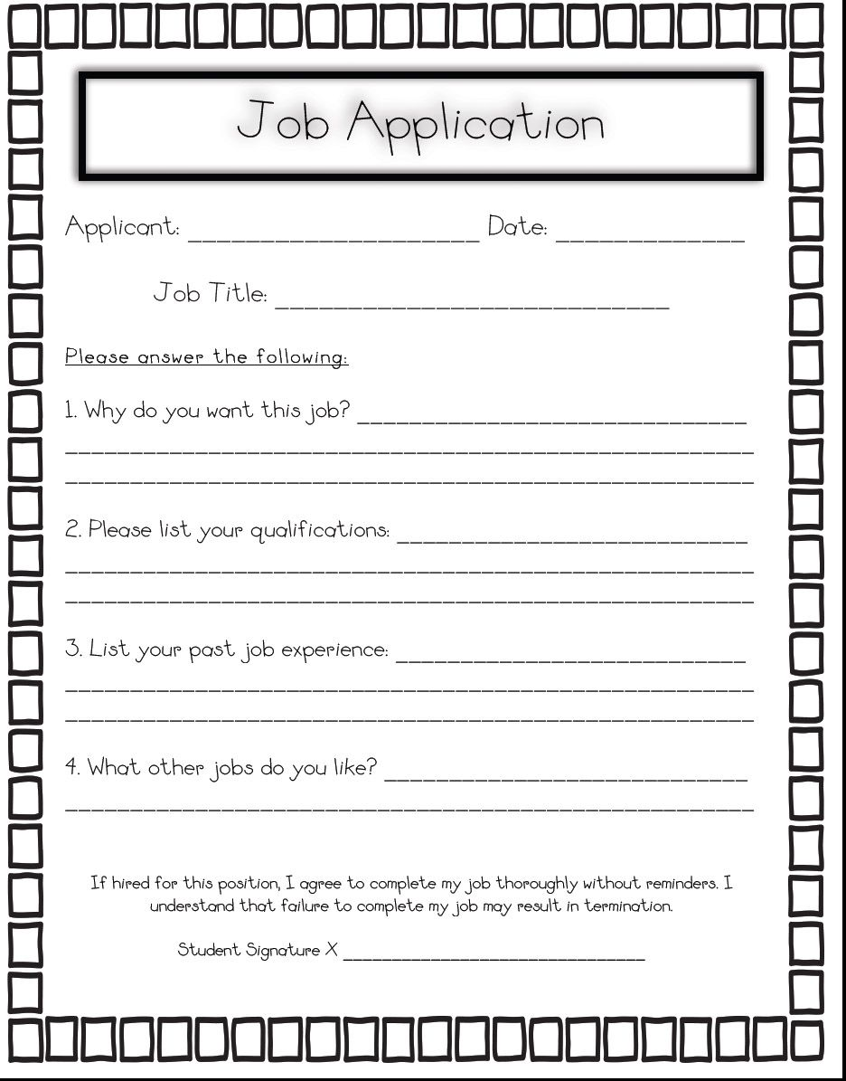
Role Description
Notes:
Let’s talk about what exactly is involved

Slide 32
Role Description
-
Ride Coordinator
Notes:
First up – Ride Coordinator (not ride leader)

Slide 33
Ride Coordinator
Responsible for organizing and planning weekly rides
Posting rides on the website
Notifying club members
Coordinating ride routes
Providing help to new riders
Weather cancellation calls
Organizing and arranging the ride leaders
Training new ride leaders
Notes:
Read Slide

Slide 34
Role Description
-
Ride Leader

Slide 35
Ride Leader (ride marshal, guide or host)
Guide riders
Ensure safety
Provide an enjoyable experience
Trained by OCA or their own club
Help ensure group follows club rules and guidelines
Notes:
A ride leader, also known as a ride marshal or ride host is a cyclist who has the skill, experience and leadership abilities to help guide others, ensure safety and provide overall enjoyment during a club ride.
They will have received Ride Leader Training from either the OCA or their own club. During the ride, they will help ensure that the group follows the guidelines outlined in their club’s Policies and Procedures or Ride Guide.

Slide 36
Ride Leaders ARE NOT!
Pulling the group the entire ride - Mingle throughout the group instead to ensure cohesiveness
Coaching – simply pointing out and enforcing club rules and etiquette
Notes:
A ride leader is not expected to be at the front pulling the group the entire ride
but mingling and integrating to ensure the overall cohesiveness of the group.
They are also not considered coaches, rather simply pointing out and enforcing club rules and etiquette.
They will be the first point of contact for troubleshooting issues, safety concerns or if an injury occurs.
A minimum of one Ride Leader is expected for each activity however it is recommended to have more than one.
Ride leaders are implementers not creators – they are the designate of the club on that day
Liability and coverage - yes

Slide 37
Ride Leader
First point of contact for troubleshooting
  Issues
  Safety Concerns
  Crashes
  Injury
*A minimum of one Ride Leader is expected or each activity, however it is recommended to have more than one*
Notes:
They will be the first point of contact for troubleshooting
*click*
Issues
*click*
Safety Concerns
*click*
Crashes
*click*
Injury
*click* *A minimum of one Ride Leader is expected or each activity, however it is recommended to have more than one*

Slide 38
Ride Leader Role Description
-
15-30min Before Ride

Slide 39
Ride Leader
15 – 30min before ride
Arrive Early
Come prepared
  Bike in good working order
  Spare tube, patch kit, pump and tire levers
  Water bottles, snacks
  Cell phone
  OCA Injury Report Form
Check memberships
  Must be members of the club (in good standing)
  Member of the OCA (UCI license, Citizen Permit)
Notes:
Read Slide:
6x*click* Check memberships!
People must either be members of your club, having purchased the affiliate club membership, If not, and they are guests, a member of the OCA holding a UCI license and citizen’s permit
COVID – spacing and PPE (mask)

Slide 40
Ride Leader Role Description
-
Pre-Ride

Slide 41
Ride Leader
Pre Ride
Introduce yourself
Describe route and stops
  Potential hazards
  When and where to re-group
  Group formations (single file, ez echelon, busy roads single file etc)
Communication
  Inform ride leader if abandoning group ride
  Hand signals etc
Introduce new riders
Notes:
So what do you think is important when you first meet with your group of people you will be riding with?
Read Slide
*click* introduce new riders – why? (feel welcome, find the right group, help make their first ride positive)

Slide 42
Ride Leader
Pre Ride
Group formation
  Break into groups based on speed/ability level
  Keep group sizes manageable
  Do a headcount
  Faster rider groups depart first
  Allow a few minutes between groups
  Separate groups, allow 100m gap between them and other groups
Notes:
Read Slide

Slide 43
Ride Leader Role Description
-
During the Ride

Slide 44
Ride Leader
During the ride
Start on time
Ride at the advertised pace
Follow advised route
Stop at indicated rest stops
Regroup whenever possible if group has broken apart
Set a safe example
  Obey traffic laws
  Stop signs and stop lights are not optional (one foot down rule)
  Signal turns and obstacles appropriately
Notes:
Read slide

Slide 45
Ride Leader
During the ride
Pay attention to new riders
  Answer questions and concerns
  Refer to someone who might be able to help
  Identify and correct problems early
      Overlapping wheels (half wheeling) especially in windy conditions
      Being unpredictable
      Not checking over shoulder before moving
      Riding too fast
      Racing
Communicate!
Notes:
Read slide
Communicate – talk to the riders, even if it’s casually, get to know the riders, you are in change!

Slide 46
Ride Leader Role Description
-
Trouble Shooting

Slide 47
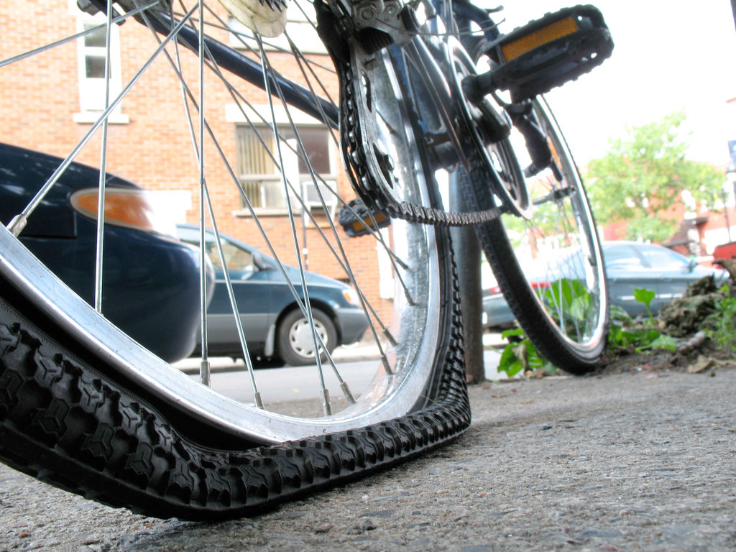
Ride Leader
Troubleshooting
Situations:
Bike not in good working order
Mechanical
  No repair kit
Dropped riders/stragglers
Exhausted cyclist
Notes:
You may also run into situations as well where you will have to problem solve
*click
Read slide with group discussion

Slide 48
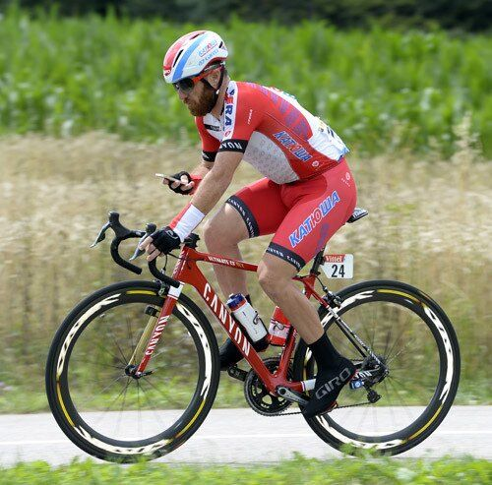
Ride Leader
Troubleshooting
Things that are not allowed:
Ear buds
Cell phone use while riding
Reckless cyclists
Uninvited guests
Notes:
There are lots of interesting and creative things that can happen during a club ride, but let’s just go over some of the basics
*click*
Read slide

Slide 49
Ride Leader Role Description
-
Injuries/Crashes

Slide 50
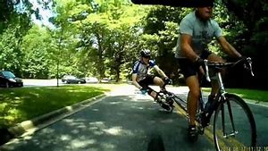
Ride Leader
Injuries/Crashes
In the event of a crash or injury:
  Stay calm – delegate responsibilities
  Remind others to stay out of harms way
  Check for danger
    Move off the road if safe and possible
    Stop or direct traffic if necessary
  Identify mechanism of injury and minimize further injury
  Don’t Move the victim if any suspicion of head/neck/back injury or broken bones
  If in doubt, call 911
Notes:
Read slide

Slide 51
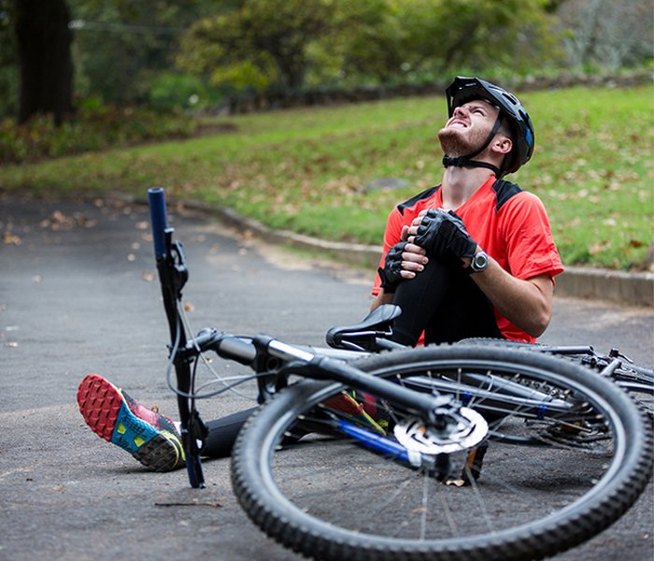
Ride Leader
Injuries/Crashes
Crash/Injury procedure:
  Check for a response from the injured rider
    Look for signs of confusion or disorientation
    Any crash resulting in a blow to the head = immediate stoppage of the ride
  Administer first aid to the best of your ability (or delegate)
  Get personal information and medical history and write it down
  Comfort the victim
  Send incident information to the club executive ASAP
Notes:
Read slide

Slide 52
Ride Leader Role Description
-
Concussions & Rowan’s Law

Slide 53

Ride Leader
Concussions & Rowan’s Law
Causes:
Impact to the head
Rapid deceleration
Crashes and collisions
Head hitting the ground
Whiplash caused by an incident

Slide 54
Ride Leader
Concussions & Rowan’s Law
Symptoms:
Loss of memory/time
Dizziness
Ringing in the ears
Nausea
Light sensitivity
Drowsiness

Slide 55
Ride Leader
Concussions & Rowan’s Law
What to do if you suspect a head injury:
Immediate removal from the sport
  We are not telling you to diagnose a concussion, you are not a doctor
  Any head injury is grounds for removal from the sport
  Get the rider home safely (pickup from family member or ambulance)
  Fill out accident report
  Club to follow up with injured person and engage in return to sport protocol as found in club concussion policy

Slide 56
Ride Leader Role Description
-
After the Ride

Slide 57
Ride Leader
After the ride
Check in with group and provide feedback/encouragement
Phone calls if concerned about injured, lost or abandoned rider
Reports for any serious mishaps or disciplinary problems sent to club executive
  Name of those involved
  Description of incident or action
  Date
  Location
  Any witnesses
Notes:
Read Slide

Slide 58
Ride Leader Role Description
-
The Ride Leader’s role is to ensure that the ride is safe and enjoyable while following the club’s risk management plan and ride guidelines.

Slide 59
Ride Leader Role Description
-
If at any point, safety of a rider is questioned, stop the ride.

Slide 60
Thank You!
On behalf of the Ontario Cycling Association – Thank you for coming!
Notes:
Time to RIDE OUR BIKES!
Some basic ride leader group ride simulations
Discuss tips on
how to be a good ride leader
safe cycling skills
managing groups of different ability levels

